Slide 1
Internet of Things
Introduction and Basic Concepts
Professor: Dr.Siavash Khorsandi
Lecturer: Jaber Babaki
Amirkabir University of Technology
Fall 2020

Slide 2


Slide 3
Contents
Introduction
Physical and Link Layers Protocols (IoT Access Technologies)
Application Layer Protocols
IoT Open problem and challenge
LoRaWAN Assignment
Mostly adopted from Chapters 4, 5, and 6 of IoT Fundamentals: Networking Technologies, Protocols, and Use Cases for the Internet of Thing, Cisco press, 2017

Slide 4
Contents
Introduction
Basic Concepts
Ecosystem
Things
Networks
Platform
Applications and Verticals
Architecture
Challenges
Business and Market Opportunities
Trends
Physical and Link Layers Protocols (IoT Access Technologies)
Application Layer Protocols

Slide 5
Contents
Introduction
Basic Concepts
Ecosystem
Things
Networks
Platform
Applications and Verticals
Architecture
Challenges
Business and Market Opportunities
Trends
Physical and Link Layers Protocols (IoT Access Technologies)
Application Layer Protocols

Slide 6
What is IoT?
"IoT" term was first introduced by Kevin Ashton in 1999.
Kevin Ashton:
If we had computers that knew everything there was to know about things—using data they gathered without any help from us—we would be able to track and count everything, and greatly reduce waste, loss and cost. We would know when things needed replacing, repairing or recalling, and whether they were fresh or past their best. We need to empower computers with their own means of gathering information, so they can see, hear and smell the world for themselves.
* Internet of Things Challenges, Advances, and Applications, CRC Press, 2018

Slide 7
What is IoT?
Cisco defines the Internet of Everything (IoE) as the networked connection of people, process, data, and things. The benefit of IoE is derived from the compound impact of connecting people, process, data, and things, and the value this increased connectedness creates as “everything” comes online.
https://www.cisco.com/c/dam/en_us/about/business-insights/docs/ioe-value-at-stake-public-sector-analysis-faq.pdf

Slide 8
What is IoT?
IoT is a world of interconnected things which are capable of sensing, actuating, and communicating among themselves and with the environment (i.e.,smart things or smart objects) while providing the ability to share information and act in parts autonomously to real/physical world events and by triggering processes and creating services with or without direct human intervention.
* Internet of Things A to Z : Technologies and Applications, IEEE Press, 2018

Slide 9
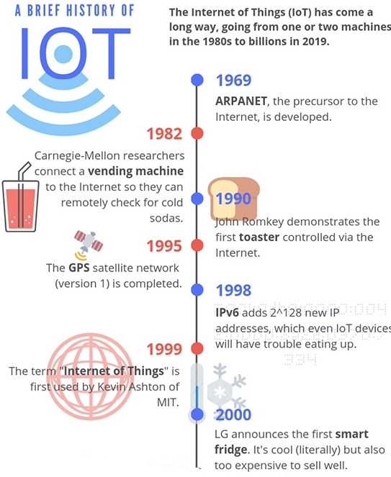
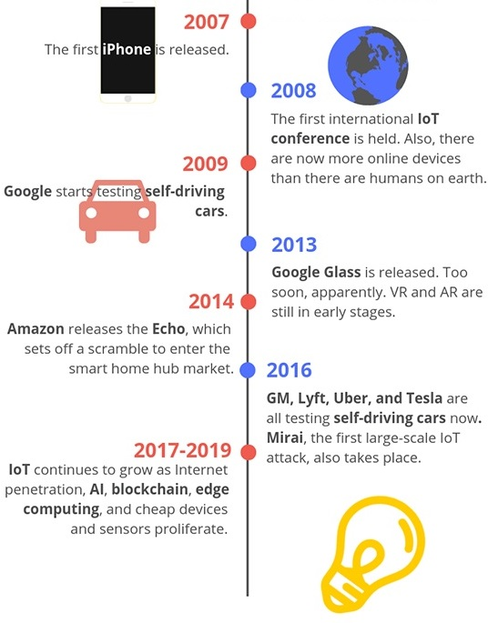
History of IoT
* https://www.iottechtrends.com/history-of-iot/
Notes:
1969: ARPANET, the precursor to the modern Internet, is developed and put into service by DARPA, the U.S Defense Advanced Research Projects agency. This is foundational to the “Internet” part of the Internet of Things.
1980s: ARPANET is opened up to the public by commercial providers, making it possible for people to connect things if they want to.
1982: Programmers at Carnegie Mellon University connect a Coca-Cola vending machine to the Internet, allowing them to check if the machine has cold sodas before going to purchase one. This is often cited as one of the first IoT devices.
1990: John Romkey, in response to a challenge, connected a toaster to the Internet and was able to successfully turn it on and off, bringing us even closer to what we think of as modern IoT devices.
1993: Engineers at the University of Cambridge, upholding the now well-established tradition of combining the Internet with appliances and food, develops a system that takes pictures of a coffee machine three times a minute, allowing its status to be remotely monitored by workers. World’s first webcam!
1995: The first version of the long-running GPS satellite program run by the U.S. government is finally completed, a big step towards proving one of the most vital components for many IoT devices: location.
1998: IPv6 becomes a draft standard, enabling more devices to connect to the internet than previously allowed by IPv4. While 32-bit IPv4 only provides enough unique identifiers for around 4.3 billion devices, 128-bit IPv6 has enough unique identifiers for up to 2^128, or 340 undecillion. (That’s 340 with 36 zeroes!)
1999: This is a big year for IoT, since it’s when the phrase was probably first used. Kevin Ashton, the head of MIT’s Auto-ID labs, included it in a presentation to Proctor & Gamble executives as a way to illustrate the potential of RFID tracking technology.
2000: LG announces what has become one of the quintessential IoT devices: the Internet refrigerator. It was an interesting idea, complete with screens and trackers to help you keep track of what you had in your fridge, but its $20,000+ USD price tag didn’t earn it a lot of love from consumers.
2004: The phrase “Internet of Things” starts popping up in book titles and makes scattered media appearances.
2007: The first iPhone appears on the scene, offering a whole new way for the general public to interact with the world and Internet-connected devices.
2008: The first international IoT conference is held in Zurich, Switzerland. The year is fitting, since it’s also the first year that the number of Internet-connected devices grew to surpass the number of humans on earth.
2009: Google starts self-driving car tests, and St. Jude Medical Center releases Internet-connected pacemakers. St. Jude’s device will go on to make yet more history by being the first IoT medical device to suffer a major security breach in 2016 (without casualties, fortunately). Also, Bitcoin starts operation, a precursor to blockchain technologies that are likely to be a big part of IoT.
2010: The Chinese government names IoT as a key technology and announces that it is part of their long-term development plan. In the same year Nest releases a smart thermostat that learns your habits and adjusts your home’s temperature automatically, putting the “smart home” concept in the spotlight.
2011: Market research firm Gartner adds IoT to their “hype cycle,” which is a graph used to measure the popularity of a technology versus its actual usefulness over time. As of 2018, IoT was just coming off of the peak of inflated expectations and may be headed for a reality check in the trough of disillusionment before ultimately hitting the plateau of productivity.
2013: Google Glass is released – a revolutionary step in IoT and wearable technology but possibly ahead of its time. It flops pretty hard.
2014: Amazon releases the Echo, paving the way for a rush into the smart home hub market. In other news, an Industrial IoT standards consortium form demonstrates the potential for IoT to change the way any number of manufacturing and supply chain processes work.
2016: General Motors, Lyft, Tesla, and Uber are all testing self-driving cars. Unfortunately, the first massive IoT malware attack is also confirmed, with the Mirai botnet assaulting IoT devices with manufacturer-default logins, taking them over, and using them to DDoS popular websites.
2017-2019: IoT development gets cheaper, easier, and more broadly-accepted, leading to small waves of innovation all over the industry. Self-driving cars continue to improve, blockchains and AI begin to be integrated into IoT platforms, and increased smartphone/broadband penetration continues to make IoT an attractive proposition for the future.

Slide 10
The growing number of connected devices)
Growing the number of connected devices to 50 billion in 2020.
* IoT Fundamentals: Networking Technologies, Protocols, and Use Cases for the Internet of Thing, Cisco press, 2017

Slide 11
Contents
Introduction
Basic Concepts
Ecosystem
Things
Networks
Platform
Applications and Verticals
Architecture
Challenges
Business and Market Opportunities
Trends
Physical and Link Layers Protocols (IoT Access Technologies)
Application Layer Protocols

Slide 12
IoT Ecosystem
*https://shankarkumarasamy.blog/2017/06/19/iot-ecosystem/

Slide 13
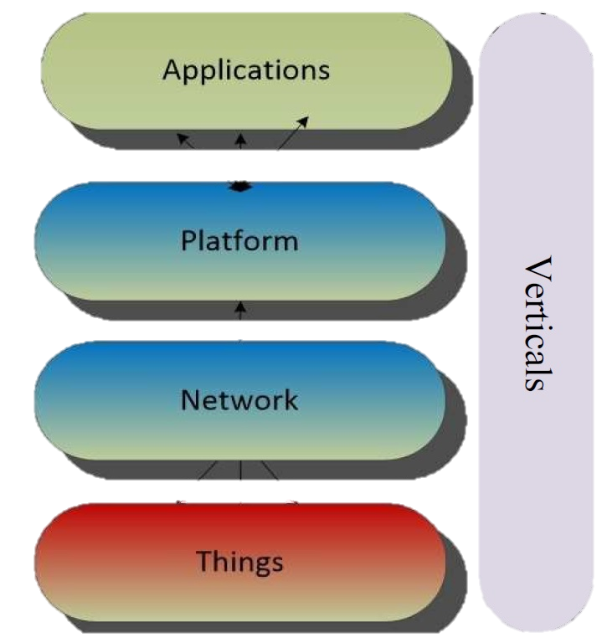
IoT Ecosystem
Things:
sensors and actuators → IoT Devices, Electronic boards
Network:
communication technologies → IoT Network Infrastructure
Platform:
- definition: A platform is a group of technologies that are used as a base upon which other applications, processes or technologies are developed.
security, process modeling and device management, data stream and information management, integration of information access mechanisms, data analysis and visualization → IoT Clouds and Data processing
Applications:
making decisions, different services and verticals, message passing protocols → Websites, Mobile applications

Slide 14
Contents
Introduction
Basic Concepts
Ecosystem
Things
Networks
Platform
Applications and Verticals
Architecture
Challenges
Business and Market Opportunities
Trends
Physical and Link Layers Protocols (IoT Access Technologies)
Application Layer Protocols

Slide 15
What are Things?
Smart objects or Things are any physical objects that contain embedded technology to sense and/or interact with their environment in a meaningful way by being interconnected and enabling communication among themselves or an external agent.
Things are
Sensors
Actuators
* IoT Fundamentals: Networking Technologies, Protocols, and Use Cases for the Internet of Thing, Cisco press, 2017
Notes:
A thing is a physical object in which a processor, data storage system, sensor system, and network technology are embedded.
Some things can also affect their environment by means of actuators.
Most things have a user interface and interaction capabilities to communicate with the environment or other devices.
The capability of things to communicate with other things and with their environment is a core component of IoT.
* Internet of Things A to Z : Technologies and Applications, IEEE Press, 2018

Slide 16
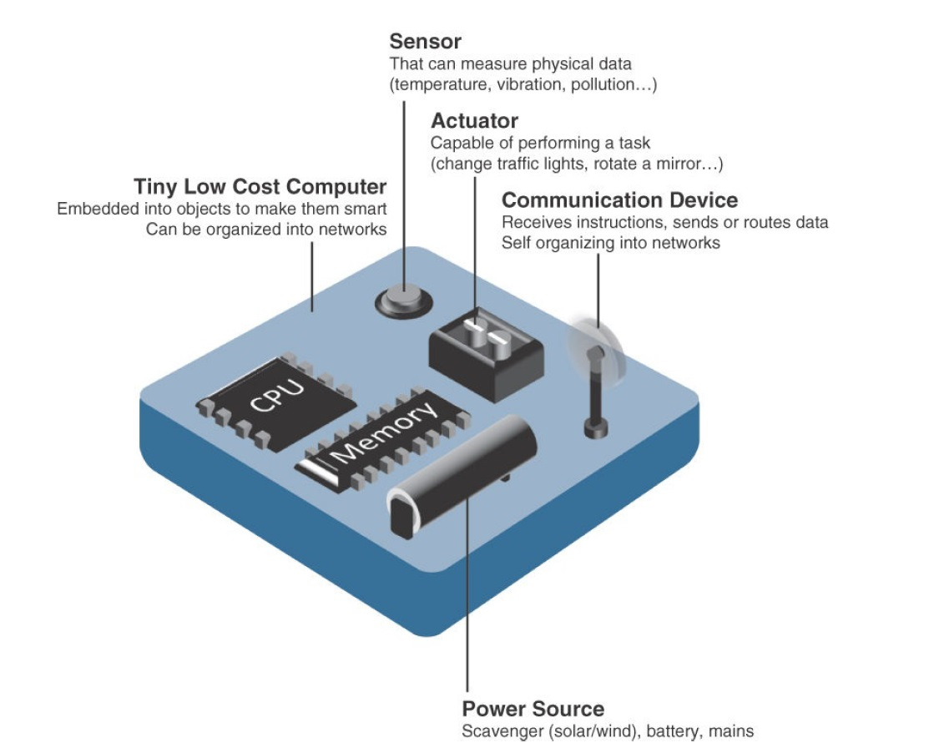
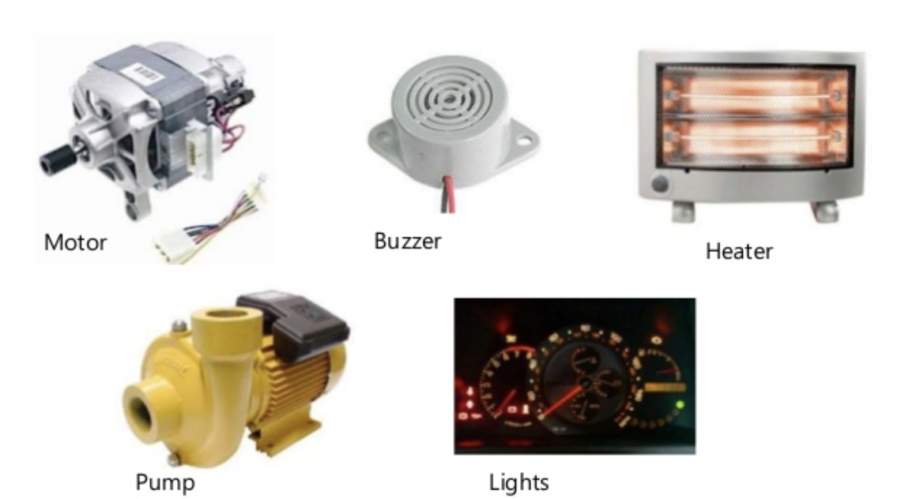
What are Things?
Sensors
Actuators
* IoT Fundamentals: Networking Technologies, Protocols, and Use Cases for the Internet of Thing, Cisco press, 2017
Notes:
A smart object is a device that has, at a minimum, the following four defining characteristics :
Processing unit: A smart object has some type of processing unit for acquiring data, processing and analyzing sensing information received by the sensor(s), coordinating control signals to any actuators, and controlling a variety of functions on the smart object, including the communication and power systems. The specific type of processing unit that is used can vary greatly, depending on the specific processing needs of different applications. The most common is a microcontroller because of its small form factor, flexibility, programming simplicity, ubiquity, low power consumption, and low cost.
Sensor(s) and/or actuator(s): A smart object is capable of interacting with the physical world through sensors and actuators. A sensor learns and measures its environment, whereas an actuator is able to produce some change in the physical world. A smart object does not need to contain both sensors and actuators. In fact, a smart object can contain one or multiple sensors and/or actuators, depending upon the application.
Communication device: The communication unit is responsible for connecting a smart object with other smart objects and the outside world (via the network). Communication devices for smart objects can be either wired or wireless. Overwhelmingly, in IoT networks smart objects are wirelessly interconnected for a number of reasons, including cost, limited infrastructure availability, and ease of deployment. There are myriad different communication protocols for smart objects.
Power source: Smart objects have components that need to be powered. Interestingly, the most significant power consumption usually comes from the communication unit of a smart object. As with the other three smart object building blocks, the power requirements also vary greatly from application to application. Typically, smart objects are limited in power, are deployed for a very long time, and are not easily accessible. This combination, especially when the smart object relies on battery power, implies that power efficiency, judicious power management, sleep modes, ultra-low power consumption hardware, and so on are critical design elements. For long-term deployments where smart objects are, for all practical purposes, inaccessible, power is commonly obtained from scavenger sources (solar, piezoelectric, and so on) or is obtained in a hybridized manner, also tapping into infrastructure power.

Slide 17
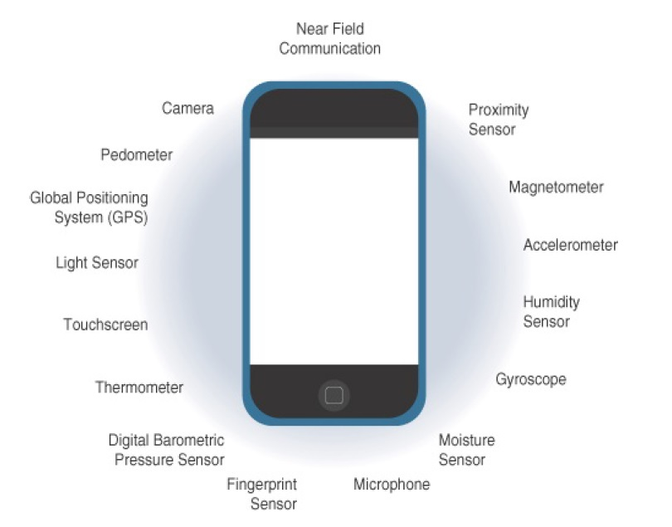
What are Things?
Sensors in smart phones
* IoT Fundamentals: Networking Technologies, Protocols, and Use Cases for the Internet of Thing, Cisco press, 2017
Notes:
حسگر «شتاب‌سنج» (Accelerometer) یکی از ابزارهای درون گوشی هوشمند است که اجازه می‌دهد این گجت، جهت حرکت را در محورهای مختلف تشخیص بدهد. این حسگر در ردیاب‌های سلامتی هم یافت می‌شود. شمارش قدم‌های کاربر در گوشی، توسط همین شتاب‌سنج‌ها صورت می‌گیرد؛ بدون این‌که نیازی به خرید گجت پوشیدنی جداگانه باشد. همچنین این حسگر جهت قرارگیری گوشی را به نرم‌افزار اطلاع می‌دهد؛ این قابلیت به‌خصوص بعد از ظهور اپ‌های واقعیت افزوده از اهمیت خیلی زیادی برخوردار شده است.
همان‌طور که از نام شتاب‌سنج مشخص است، این حسگر شتاب را اندازه‌گیری می‌کند تا به‌طور مثال در هنگام حرکت، نقشه‌ی اسنپ‌چت بتواند آواتار کاربر را در یک ماشین روی نقشه قرار دهد. علاوه بر این استفاده‌ی مفرح، شتاب‌سنج در انواع و اقسام برنامه‌ها به کار گرفته می‌شود. خود این حسگر از حسگرهای دیگری ازجمله ساختارهای کریستالی میکروسکوپی تشکیل شده است که براثر نیروهای شتاب‌دهنده تحت فشار قرار می‌گیرند. سپس شتاب‌سنج، ولتاژهای برآمده از کریستال‌ها را تفسیر می‌کند تا بتواند سرعت گوشی و جهت آن را تشخیص دهد. از تغییر جهت دادن اپ‌ها از حالت عمودی به افقی گرفته تا نمایش سرعت در هنگام رانندگی، شتاب‌سنج کارکردهای زیادی در گوشی دارد و به همین خاطر، شتاب‌سنج را می‌توان از مهم‌ترین حسگرهای گوشی به‌حساب آورد.
‌
«ژیروسکوپ» (Gyroscope) برای درک جهت قرارگیری گوشی به شتاب‌سنج کمک می‌کند. این حسگر دقت گوشی را بالاتر می‌برد تا مثلا عکس‌های ۳۶۰ درجه تا حد ممکن زیبا و جذاب شوند. هر وقت که مشغول یک بازی رانندگی با موبایلتان هستید و برای کنترل فرمان جهت گوشی را تغییر می‌دهید، به‌جای شتاب‌سنج، این ژیروسکوپ است که وارد عمل می‌شود. به این دلیل که فقط تکان‌های کوچکی به گوشی داده می‌شود و گجت واقعا حرکتی در فضا ندارد.
منبع:
https://www.digikala.com/mag/%D8%AD%D8%B3%DA%AF%D8%B1-%DA%AF%D9%88%D8%B4%DB%8C-%D9%87%D9%88%D8%B4%D9%85%D9%86%D8%AF-%DA%86%DA%AF%D9%88%D9%86%D9%87-%DA%A9%D8%A7%D8%B1-%D9%85%DB%8C%E2%80%8C%DA%A9%D9%86%D8%AF/

Slide 18
Sensors
Measures some physical quantity and converts it into a digital representation.
That digital representation is typically passed to another device for transformation into useful data that can be consumed by intelligent devices or humans.
Sensors can be readily embedded in any physical objects that are easily connected to the Internet by wired or wireless networks.
Because these connected host physical objects with multidimensional sensing capabilities communicate with each other and external systems, they can interpret their environment and make intelligent decisions.
* IoT Fundamentals: Networking Technologies, Protocols, and Use Cases for the Internet of Thing, Cisco press, 2017
Notes:
Sensors
A sensor measures some physical quantity and converts that measurement reading into a digital representation.
That digital representation is typically passed to another device for transformation into useful data that can be consumed by intelligent devices or humans.
Sensors can be readily embedded in any physical objects that are easily connected to the Internet by wired or wireless networks.
Because these connected host physical objects with multidimensional sensing capabilities communicate with each other and external systems, they can interpret their environment and make intelligent decisions.

Slide 19
Sensors
Example of Sensor Applications Based on Mobility and Throughput
* IoT Fundamentals: Networking Technologies, Protocols, and Use Cases for the Internet of Thing, Cisco press, 2017
Notes:
Sensors
Different types of sensors
Active or passive: Sensors can be categorized based on whether they produce an energy output and typically require an external power supply (active) or whether they simply receive energy and typically require no external power supply (passive).
Invasive or non-invasive: Sensors can be categorized based on whether a sensor is part of the environment it is measuring (invasive) or external to it (non-invasive).
Contact or no-contact: Sensors can be categorized based on whether they require physical contact with what they are measuring (contact) or not (no-contact).
Absolute or relative: Sensors can be categorized based on whether they measure on an absolute scale (absolute) or based on a difference with a fixed or variable reference value (relative).
Area of application: Sensors can be categorized based on the specific industry or vertical where they are being used.
How sensors measure: Sensors can be categorized based on the physical mechanism used to measure sensory input (for example, thermoelectric, electrochemical, piezoresistive, optic, electric, fluid mechanic, photoelastic).
What sensors measure: Sensors can be categorized based on their applications or what physical variables they measure.

Slide 20
Actuators
Actuators receive some type of control signal (commonly an electric signal or digital command) that triggers a physical effect, usually some type of motion, force, and so on.
* IoT Fundamentals: Networking Technologies, Protocols, and Use Cases for the Internet of Thing, Cisco press, 2017

Slide 21
Contents
Introduction
Basic Concepts
Ecosystem
Things
Networks
Platform
Applications and Verticals
Architecture
Challenges
Business and Market Opportunities
Trends
Physical and Link Layers Protocols (IoT Access Technologies)
Application Layer Protocols

Slide 22
IoT Networks
Having determined the smart object and its required transmission capabilities (transmission range, data volume and frequency, sensor density and mobility), you are ready to connect the object and communicate.
A first step in designing an IoT network is to examine the requirements in terms of mobility and data transmission (how much data, how often, how long, how much power).
IoT Network is the communication domain for the IoT devices and endpoints.
It includes the devices themselves and the communications network that links them.
* IoT Fundamentals: Networking Technologies, Protocols, and Use Cases for the Internet of Thing, Cisco press, 2017

Slide 23
Access Technologies and Distances

Slide 24
Contents
Introduction
Basic Concepts
Ecosystem
Things
Networks
Platform
Applications and Verticals
Architecture
Challenges
Business and Market Opportunities
Trends
Physical and Link Layers Protocols (IoT Access Technologies)
Application Layer Protocols

Slide 25
IoT Platforms
IoT platforms are the central piece in the Internet of Things architecture that connect the real and the virtual worlds and enable communication between objects.
In its most simple form, an IoT platform is just about enabling connectivity between objects.
In a more sophisticated form, the platform consists of a variety of important building blocks:
device management,
database,
processing and action management,
analytics,
visualization,
additional tools, and
external interfaces
IoT Platforms, IoT Analytics, 2015
https://medium.com/schaffen-softwares/part-4-iot-platforms-b8f2c4e4639b
Notes:
CONNECTIVITY and NORMALIZATION
Every IoT platform starts with a connectivity layer. It has the function of bringing different protocols and different data formats into one “software” interface. This is necessary in order to ensure all devices can be interacted with and data is read correctly. Having all device data in one place and in one format is the basic necessity to monitor, manage, and analyze IoT devices. What sounds fairly simple can be a nightmare from the point of view of a computer engineer. Libraries need to be set up for individual devices so that something as basic as an industrial pressure sensor that sends analogue signals can be integrated into the platform for one use case while a wearable device or the data from someone’s smartphone can be integrated for another use case. Advanced devices usually provide an API that allows for a standardized communication interface to the platform. However, very often so-called software agents have to be developed and installed on the hardware in order to enable the IoT platform to establish a stable connection.
2. DEVICE MANAGEMENT
The device management module of an IoT platform ensures the connected objects are working properly and its software and applications are updated and running. Tasks performed in this module include device provisioning, remote configuration, management of firmware/ software updates, and troubleshooting. As thousands or even millions of different devices become part of an IoT enabled solution, bulk-actions, and automation are essential to control costs and reduce manual labor.
3. DATABASE
Data storage is a central piece in an IoT platform. The management of device data brings the requirements for databases to a new level:
• Volume. The amount of data that needs to be stored can be massive. In many IoT solutions only the minority of the generated data can be stored.
• Variety. Different devices and different sensor types produce very different forms of data.
• Velocity. Many IoT cases require the analysis of streaming data to make instant decisions.
• Veracity. In some instances, sensors produce ambiguous and inaccurate data. An IoT platform therefore usually comes with a cloud based database solution that is distributed across different sensor nodes. It should be scalable for big data and should be able to store both structured (SQL) and unstructured data (NoSQL).
4. PROCESSING & ACTION MANAGEMENT
The data that is captured in the connectivity & normalization module and that is stored in the database gets brought to life in this part of the IoT platform. A rule-based event-action-trigger allows performance of “smart” actions based on specific sensor data. In a smart home, for instance, an event-action-trigger can be defined so that all lights get turned off when a person leaves the house. The technical realization often comes in the form of an If-this-then-that rule (IFTTT): If the GPS signal indicates Jason’s smartphone is more than 5 yards away from his house, then turn off all the lights in his house.
5. ANALYTICS
Many IoT use cases go beyond action-management and require complex analytics to get the most out of the IoT data-stream. In a smart home, for example, the analytics engine can provide the algorithms that allow the IoT platform to learn which combination of lights and heating are preferred by the user at what time of the day and in relation to the outside weather conditions..The analytics engine encompasses all dynamic calculations of sensor data, from basic data clustering to deep machine learning.
6. DATA VISUALIZATION
Sometimes also referred to as “visual analytics,” data visualization presents a much-underrated part of the IoT platform. The combination of human eye and brain is still far superior to most analytic and rule-based engines. That is why data visualization is so important: it enables humans to see patterns and observe trends. Visualization comes in the form of line-, stacked-, or pie charts, 2D- or even 3D-models. The visualization dashboard that is available to the manager of the IoT platform is often also included in the prototyping tools that an advanced IoT platform provides.
7. ADDITIONAL TOOLS
Advanced IoT platforms often offer an additional set of tools for the developer and the manager of the IoT solution. Development tools allow the IoT developer to prototype and test the IoT case. Sometimes even in the form of what-you-see-is-what-you-get-editors (WYSIWYG) that lets you create simple smartphone apps for visualizing and controlling connected devices. Management-focused tools support the daily operations of the IoT solution. An example is an „access management“ tool that determines who has access to which device and to which data. Another tool is “reporting”, that allows for data export (e.g., in a.csv or.json format) as well as data queries and other forms of structured output.
8. EXTERNAL INTERFACES
IoT enabled businesses are rarely built standalone and on a green field. In established companies it is crucial that the Internet of Things integrates with existing ERP systems, management tools, manufacturing execution systems and the rest of the wider IT-ecosystem.

Slide 26
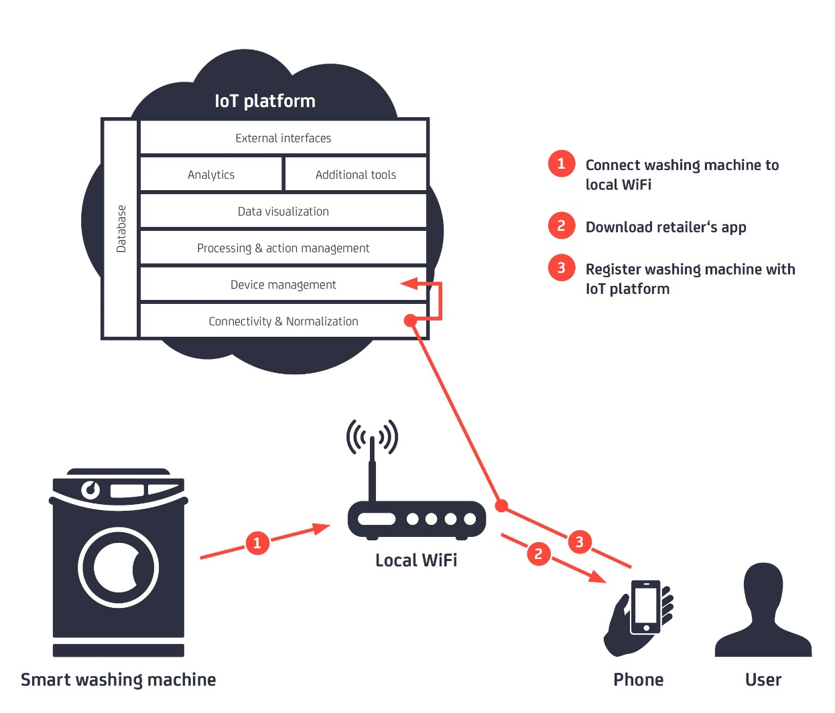
IoT Platforms
* IoT Platforms, IoT Analytics, 2015, https://www.educba.com/iot-platform/

Slide 27
Contents
Introduction
Basic Concepts
Ecosystem
Things
Networks
Platform
Applications and Verticals
Architecture
Challenges
Business and Market Opportunities
Trends
Physical and Link Layers Protocols (IoT Access Technologies)
Application Layer Protocols

Slide 28
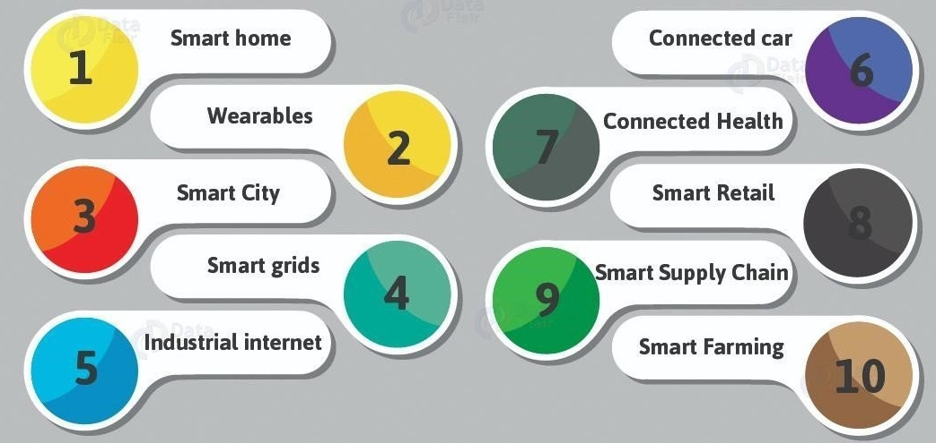
IoT Applications and Verticals
* https://www.meee-services.com/category/artificial-intelligence/

Slide 29
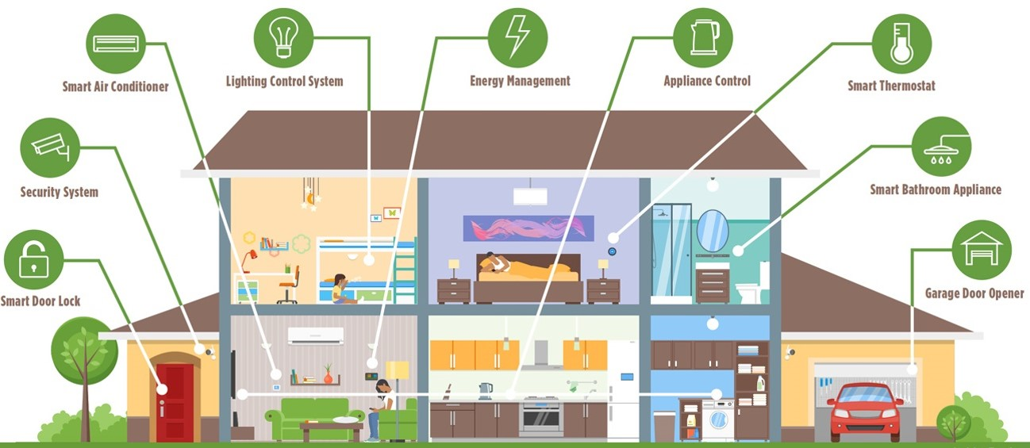
IoT Applications and Verticals- Smart Home
Smart Home
* https://www.bluebonnetelectric.coop/Community/News/articles/2016/Magazine-Stories/HOME,-SMART-HOME-Trends-in-residential-technology

Slide 30
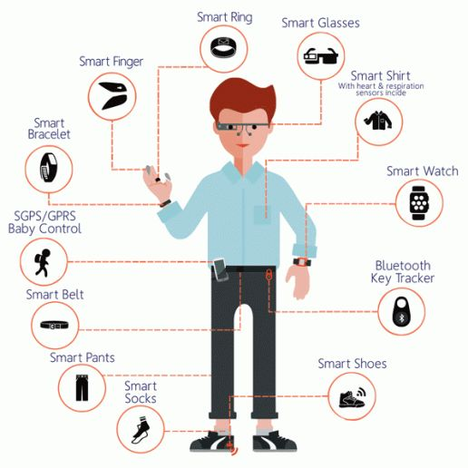
IoT Applications and Verticals- Smart Wearables
* https://www.quora.com/Why-the-boom-of-wearable-devices

Slide 31
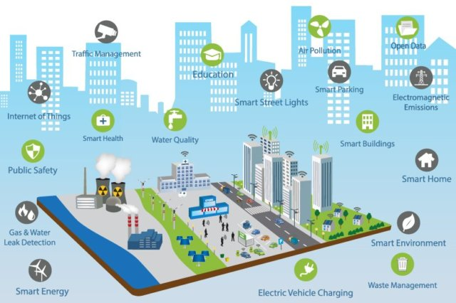
IoT Applications and Verticals- Smart City
Smart City
* https://www.ifpenergiesnouvelles.com/article/smart-city-energy-challenges-facing-sustainable-cities

Slide 32
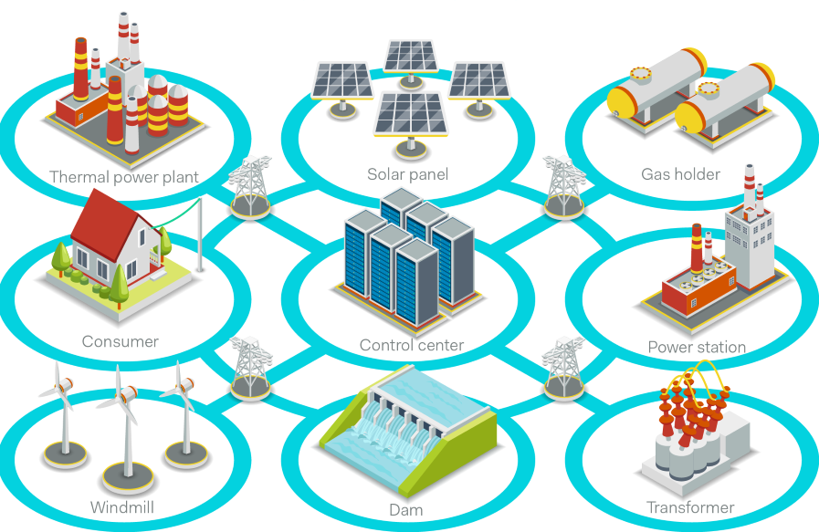
IoT Applications and Verticals- Smart Grid
* https://www.powerelectronicsnews.com/technology/is-your-smart-grid-secured

Slide 33
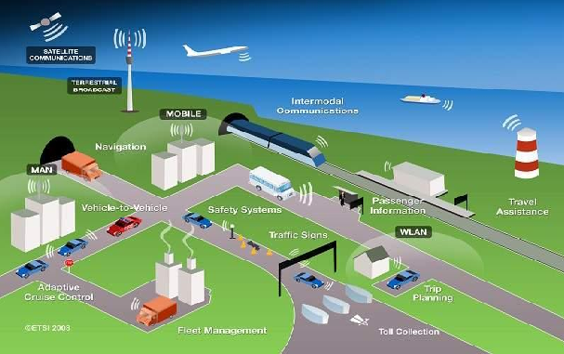
IoT Applications and Verticals- Smart Transportation
* https://www.sentinelassam.com/editorial/intelligent-transportation-system-and-smart-city-4/

Slide 34
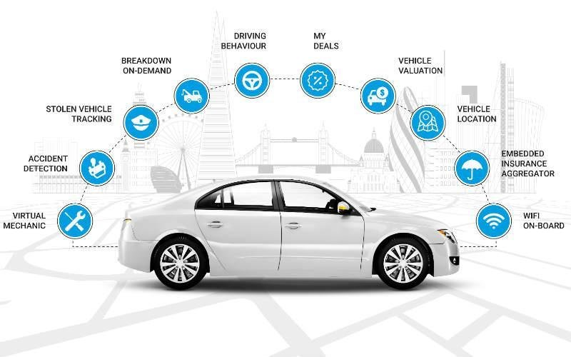
IoT Applications and Verticals- Connected Car
* https://www.researchgate.net/figure/Function-of-connected-car_fig1_323258412

Slide 35
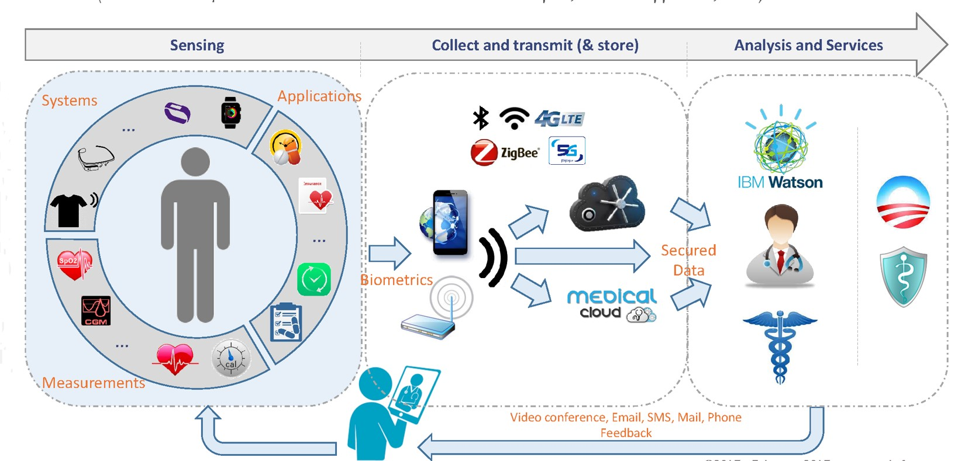
IoT Applications and Verticals- Connected Health
* http://www.yole.fr/IoT_Seminar_Yole_FraunhoferEMFT.aspx

Slide 36
IoT Applications and Verticals- Smart Retail
* https://www.42gears.com/blog/how-iot-is-changing-retail-industry/

Slide 37
IoT Applications and Verticals- Smart Farming
Context
* https://volansys.com/modular-iot-gateway/

Slide 38
Contents
Introduction
Basic Concepts
Ecosystem
Things
Networks
Platform
Applications and Verticals
Architecture
Challenges
Business and Market Opportunities
Trends
Physical and Link Layers Protocols (IoT Access Technologies)
Application Layer Protocols

Slide 39
IoT Architectures
a: 3 layer architecture, b: 3 layer architecture, c: 4 layer architecture1 d: 4 layer architecture2

Slide 40
IoT 7 layer architecture by cisco
* IoT Fundamentals: Networking Technologies, Protocols, and Use Cases for the Internet of Thing, Cisco press, 2017
Notes:
As shown in Figure 2-2, the IoT Reference Model defines a set of levels with
control flowing from the center (this could be either a cloud service or a
dedicated data center), to the edge, which includes sensors, devices,
machines, and other types of intelligent end nodes. In general, data travels up
the stack, originating from the edge, and goes northbound to the center.

Slide 41
Contents
Introduction
Basic Concepts
Ecosystem
Things
Networks
Platform
Applications and Verticals
Architecture
Challenges
Business and Market Opportunities
Trends
Physical and Link Layers Protocols (IoT Access Technologies)
Application Layer Protocols

Slide 42
IoT Challenges
Scalability
Security
Privacy
Big Data and Data Analytics
Interoperability
* IoT Fundamentals: Networking Technologies, Protocols, and Use Cases for the Internet of Thing, Cisco press, 2017

Slide 43
IoT Challenges
Scalability
The IPv4 address space has reached exhaustion and is unable to meet IoT’s scalability requirements.
For IoT scale can be met only by IPv6.
Security
Privacy
Big Data and Data Analytics
Interoperability
IoT Fundamentals: Networking Technologies, Protocols, and Use Cases for the Internet of Thing, Cisco press, 2017
https://rezwanlink.wordpress.com/tag/ipv4-vs-ipv6/

Slide 44
IoT Challenges
Scalability
Security
With more “things” connected with other “things” and people security is an increasingly complex issue for IoT.
Threat surface is greatly expanded and if device gets hacked, its connectivity is a major concern.
A Compromised device can serve as a launching point to attack other devices and systems.
Privacy
Big Data and Data Analytics
Interoperability
* IoT Fundamentals: Networking Technologies, Protocols, and Use Cases for the Internet of Thing, Cisco press, 2017

Slide 45
IoT Challenges
Scalability
Security
Privacy
A sensor become more prolific in every day lives, the data what they gather will be specific to individuals and their activities.
For Businesses, the data has monetary value.
Organization discusses about who owns the data and how individuals can control whether it is shared and with whom.
Big Data and Data Analytics
Interoperability
IoT Fundamentals: Networking Technologies, Protocols, and Use Cases for the Internet of Thing, Cisco press, 2017
https://internetofbusiness.com/consumers-demand-more-data-privacy-from-the-iot-economist-report/

Slide 46
IoT Challenges
Scalability
Security
Privacy
Big Data and Data Analytics
IoT and large number of sensors are going to trigger deluge of data that must be handled.
This data will provide critical information and insights if it can be processed in an efficient manner.
Challenge is evaluating massive amounts of data arriving from different sources in various forms and doing so in a timely manner.
Interoperability
IoT Fundamentals: Networking Technologies, Protocols, and Use Cases for the Internet of Thing, Cisco press, 2017
https://www.karmelsoft.com/big-data-and-the-internet-of-things/

Slide 47
IoT Challenges (cont’d)
Scalability
Security
Privacy
Big Data and Data Analytics
Interoperability
As with nascent technology, various protocols and architectures are jockeying for market share and standardizations within IoT.
Some of these protocols and architectures are based on proprietary elements and others are open.
Recently IoT Standards are helping minimize this problem, but there are often various protocols and implementations available for IoT networks.
* IoT Fundamentals: Networking Technologies, Protocols, and Use Cases for the Internet of Thing, Cisco press, 2017

Slide 48
Contents
Introduction
Basic Concepts
Ecosystem
Things
Networks
Platform
Applications and Verticals
Architecture
Challenges
Business and Market Opportunities
Trends
Physical and Link Layers Protocols (IoT Access Technologies)
Application Layer Protocols

Slide 49
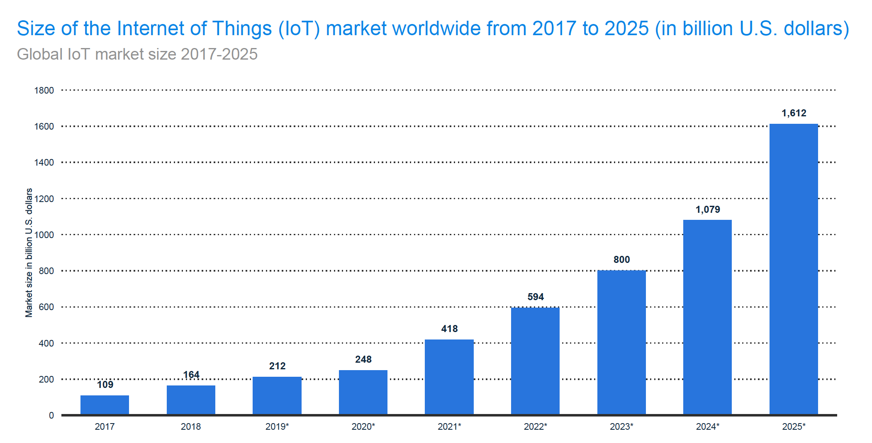
IoT Global market size 2017-2025
https://www.statista.com/

Slide 50
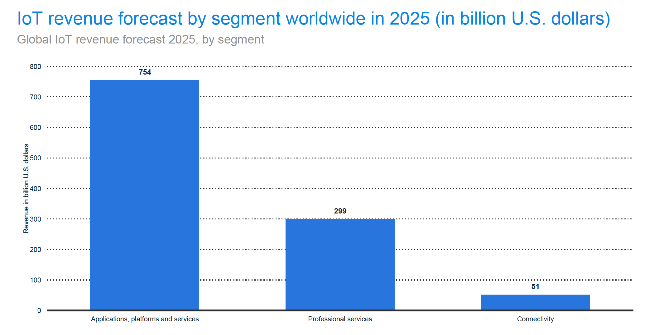
IoT revenue forecast by segment

Slide 51
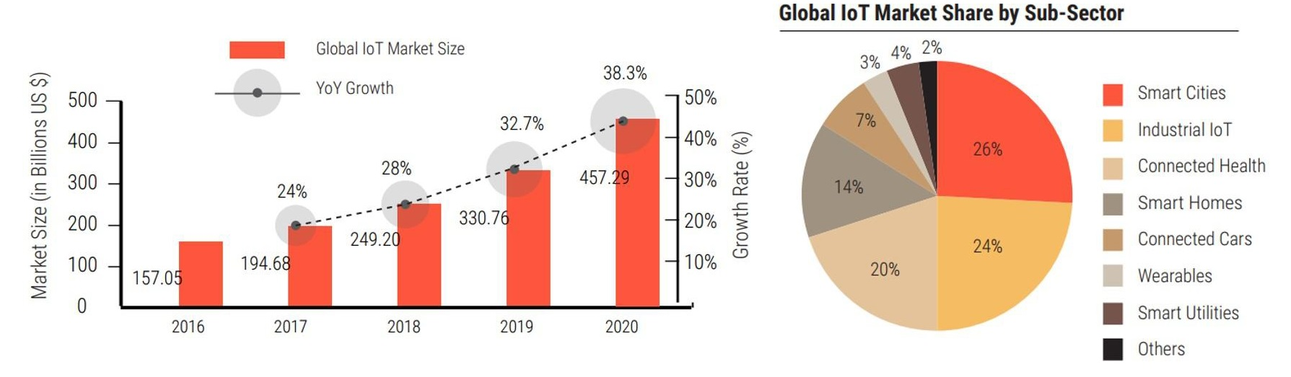
IoT Business and Market Opportunities
* https://dreamziot.com/the-upcoming-iot-market/
Notes:
With urbanization and globalization on the boom, IoT has seen a very promising growth in the market. Acting as a bridge between the physical and the digital world, Internet of Things is enabling various organizations to create a completely different experience not just for themselves but for their consumer as well. In the past couple of years, market statistics reveal that more and more organizations are willing to experiment with IoT because of their higher expectations for ROI from their large-scale initiatives. The KPIs not only indicate operational improvements, supply chain gains, better logistics but also better customer satisfaction.
Let us have a detailed insight into the revenue break up of IoT in the market and where it would stand in the coming years.”According to IDC, worldwide spending on the IoT is forecast to reach $772.5B in 2018. That represents an increase of 15% over the $674B that was spent on IoT in 2017. By the end of 2020, close to 50% of new IoT applications built by enterprises will leverage an IoT platform that offers outcome-focused functionality based on comprehensive analytics capabilities.
The global IoT market will grow from $157B in 2016 to $457B by 2020, attaining a Compound Annual Growth Rate (CAGR) of 28.5%. Discrete Manufacturing, Transportation and Logistics, and Utilities will lead all industries in IoT spending by 2020, averaging $40B each.”

Slide 52
Contents
Introduction
Basic Concepts
Ecosystem
Things
Networks
Platform
Applications and Verticals
Architecture
Challenges
Business and Market Opportunities
Trends
Physical and Link Layers Protocols (IoT Access Technologies)
Application Layer Protocols

Slide 53
IoT Trends
Artificial Intelligence
Social, Legal, and Ethical IoT
IoT Governance
Sensor Innovation
Trusted Hardware and Operating System
IoT User Experiences
New Wireless Networking Technologies for IoT
* https://www.gartner.com/en/newsroom/press-releases/2018-11-07-gartner-identifies-top-10-strategic-iot-technologies-and-trends
Notes:
Trend No. 1: Artificial Intelligence (AI)
Gartner forecasts that 14.2 billion connected things will be in use in 2019, and that the total will reach 25 billion by 2021, producing immense volume of data. “Data is the fuel that powers the IoT and the organization’s ability to derive meaning from it will define their long term success,” said Mr. Jones. “AI will be applied to a wide range of IoT information, including video, still images, speech, network traffic activity and sensor data.”
The technology landscape for AI is complex and will remain so through 2023, with many IT vendors investing heavily in AI, variants of AI coexisting, and new AI-based tolls and services emerging. Despite this complexity, it will be possible to achieve good results with AI in a wide range of IoT situations. As a result, CIOs must build an organization with the tools and skills to exploit AI in their IoT strategy.
Trend No. 2: Social, Legal and Ethical IoT
As the IoT matures and becomes more widely deployed, a wide range of social, legal and ethical issues will grow in importance. These include ownership of data and the deductions made from it; algorithmic bias; privacy; and compliance with regulations such as the General Data Protection Regulation.
“Successful deployment of an IoT solution demands that it’s not just technically effective but also socially acceptable,” said Mr. Jones. “CIOs must, therefore, educate themselves and their staff in this area, and consider forming groups, such as ethics councils, to review corporate strategy. CIOs should also consider having key algorithms and AI systems reviewed by external consultancies to identify potential bias.”
Trend No. 3: Infonomics and Data Broking
Last year’s Gartner survey of IoT projects showed 35 percent of respondents were selling or planning to sell data collected by their products and services. The theory of infonomics takes this monetization of data further by seeing it as a strategic business asset to be recorded in the company accounts. By 2023, the buying and selling of IoT data will become an essential part of many IoT systems. CIOs must educate their organizations on the risks and opportunities related to data broking in order to set the IT policies required in this area and to advise other parts of the organization.
Trend No. 4: The Shift from Intelligent Edge to Intelligent Mesh
The shift from centralized and cloud to edge architectures is well under way in the IoT space. However, this is not the end point because the neat set of layers associated with edge architecture will evolve to a more unstructured architecture comprising of a wide range of “things” and services connected in a dynamic mesh. These mesh architectures will enable more flexible, intelligent and responsive IoT systems — although often at the cost of additional complexities. CIOs must prepare for mesh architectures’ impact on IT infrastructure, skills and sourcing.
Trend No. 5: IoT Governance
As the IoT continues to expand, the need for a governance framework that ensures appropriate behavior in the creation, storage, use and deletion of information related to IoT projects will become increasingly important. Governance ranges from simple technical tasks such as device audits and firmware updates to more complex issues such as the control of devices and the usage of the information they generate. CIOs must take on the role of educating their organizations on governance issues and in some cases invest in staff and technologies to tackle governance.
Trend No. 6: Sensor Innovation
The sensor market will evolve continuously through 2023. New sensors will enable a wider range of situations and events to be detected, current sensors will fall in price to become more affordable or will be packaged in new ways to support new applications, and new algorithms will emerge to deduce more information from current sensor technologies. CIOs should ensure their teams are monitoring sensor innovations to identify those that might assist new opportunities and business innovation.
Trend No. 7: Trusted Hardware and Operating System
Gartner surveys invariably show that security is the most significant area of technical concern for organizations deploying IoT systems. This is because organizations often don’t have control over the source and nature of the software and hardware being utilised in IoT initiatives. “However, by 2023, we expect to see the deployment of hardware and software combinations that together create more trustworthy and secure IoT systems,” said Mr. Jones. “We advise CIOs to collaborate with chief information security officers to ensure the right staff are involved in reviewing any decisions that involve purchasing IoT devices and embedded operating systems.”
Trend 8: Novel IoT User Experiences
The IoT user experience (UX) covers a wide range of technologies and design techniques. It will be driven by four factors: new sensors, new algorithms, new experience architectures and context, and socially aware experiences. With an increasing number of interactions occurring with things that don’t have screens and keyboards, organizations’ UX designers will be required to use new technologies and adopt new perspectives if they want to create a superior UX that reduces friction, locks in users, and encourages usage and retention.
Trend No. 9: Silicon Chip Innovation
“Currently, most IoT endpoint devices use conventional processor chips, with low-power ARM architectures being particularly popular. However, traditional instruction sets and memory architectures aren’t well-suited to all the tasks that endpoints need to perform,” said Mr. Jones. “For example, the performance of deep neural networks (DNNs) is often limited by memory bandwidth, rather than processing power.”
By 2023, it’s expected that new special-purpose chips will reduce the power consumption required to run a DNN, enabling new edge architectures and embedded DNN functions in low-power IoT endpoints. This will support new capabilities such as data analytics integrated with sensors, and speech recognition included in low cost battery-powered devices. CIOs are advised to take note of this trend as silicon chips enabling functions such as embedded AI will in turn enable organizations to create highly innovative products and services.
Trend No. 10: New Wireless Networking Technologies for IoT
IoT networking involves balancing a set of competing requirements, such as endpoint cost, power consumption, bandwidth, latency, connection density, operating cost, quality of service, and range. No single networking technology optimizes all of these and new IoT networking technologies will provide CIOs with additional choice and flexibility. In particular they should explore 5G, the forthcoming generation of low earth orbit satellites, and backscatter networks

Slide 54
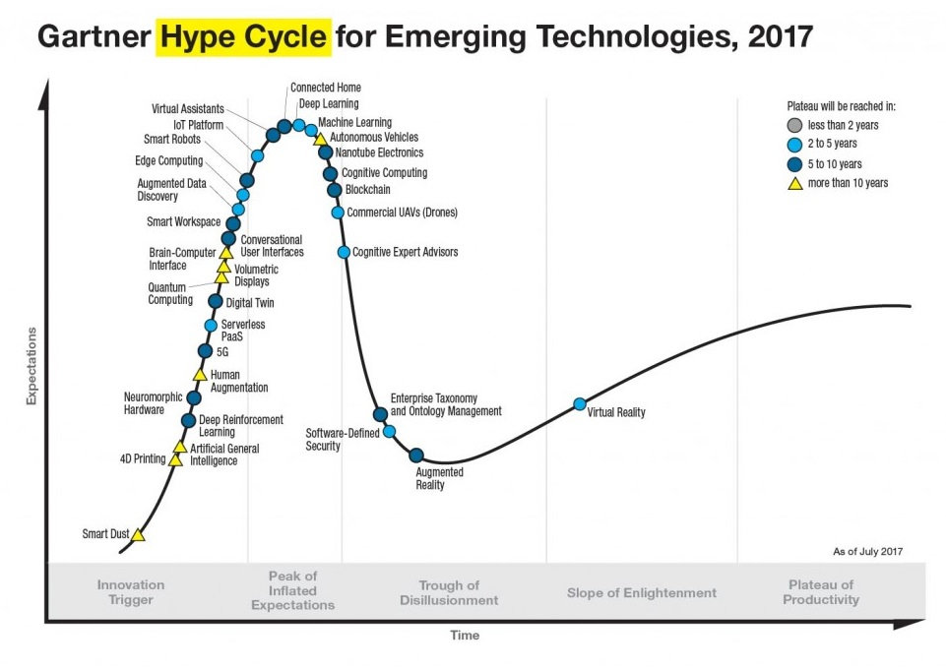
IoT Trends
* https://gartner.com

Slide 55
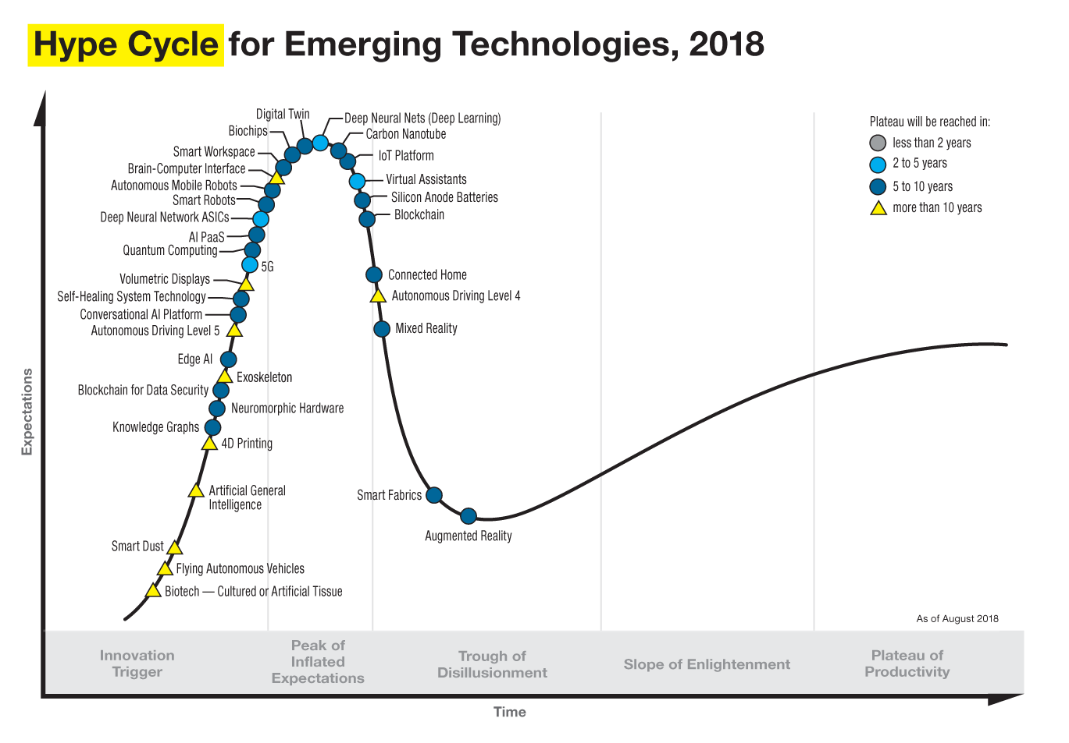
IoT Trends
* https://gartner.com

Slide 56
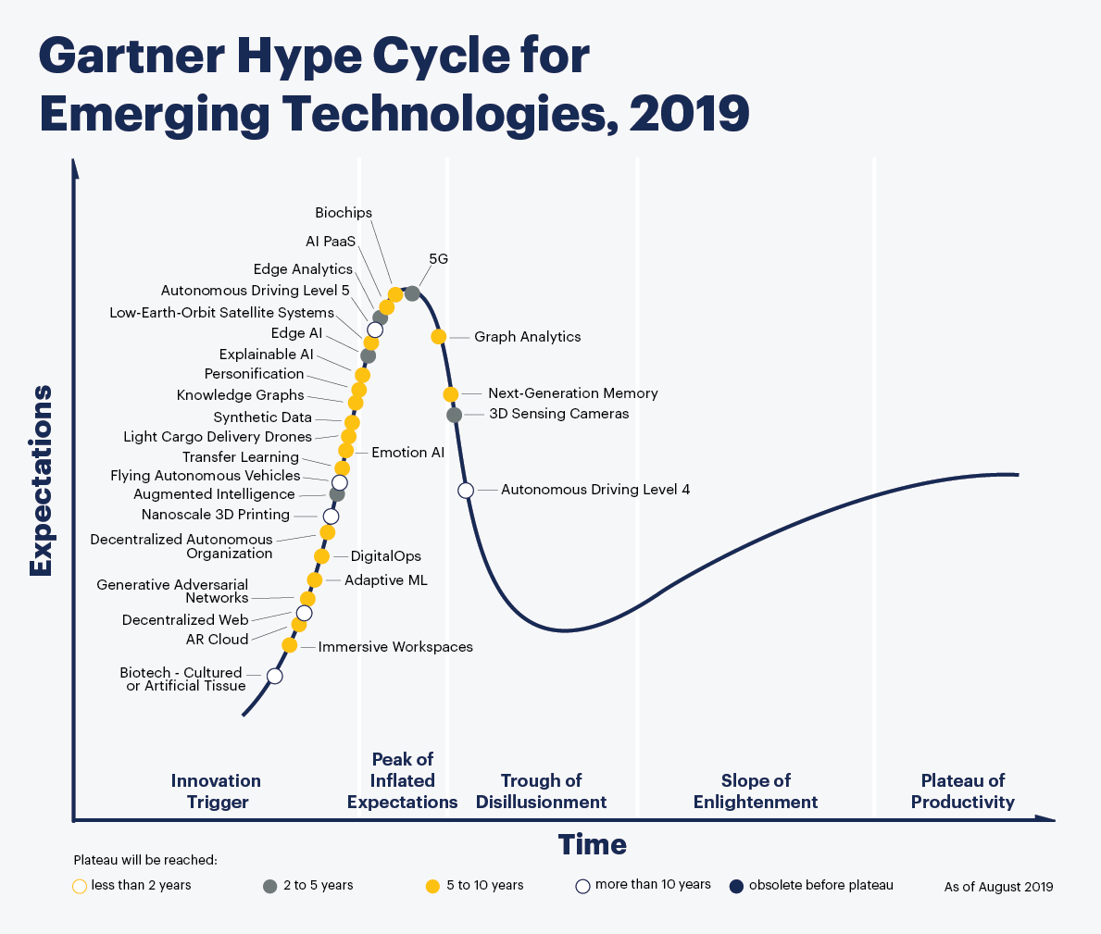
IoT Trends
* https://gartner.com
Notes:
why does not gartner hype cycle 2019 include iot?
Edge AI – Edge AI refers to the use of AI techniques embedded in IoT endpoints, gateways, and edge devices, in applications ranging from autonomous vehicles to streaming analytics. (https://www.enterpriseirregulars.com/144131/whats-new-in-gartners-hype-cycle-for-ai-2019/)

Slide 57
09384904562
Jaber.babaki94@gmail.com
@jaberalu
چیزهای عالی هرگز در راحتی بدست نمی آید.
Notes:
why does not gartner hype cycle 2019 include iot?
Edge AI – Edge AI refers to the use of AI techniques embedded in IoT endpoints, gateways, and edge devices, in applications ranging from autonomous vehicles to streaming analytics. (https://www.enterpriseirregulars.com/144131/whats-new-in-gartners-hype-cycle-for-ai-2019/)

